Slide 1

Facial Expression Recognition Using Vision Transformers and Convolutional Neural Networks
by
Muhammet Hakan Taştan
Approved by Prof. Dr. Duygun Erol Barkana (Advisor)
Faculty of Engineering
Department of Electrical and Electronics Engineering
Istanbul, 2023

Slide 2
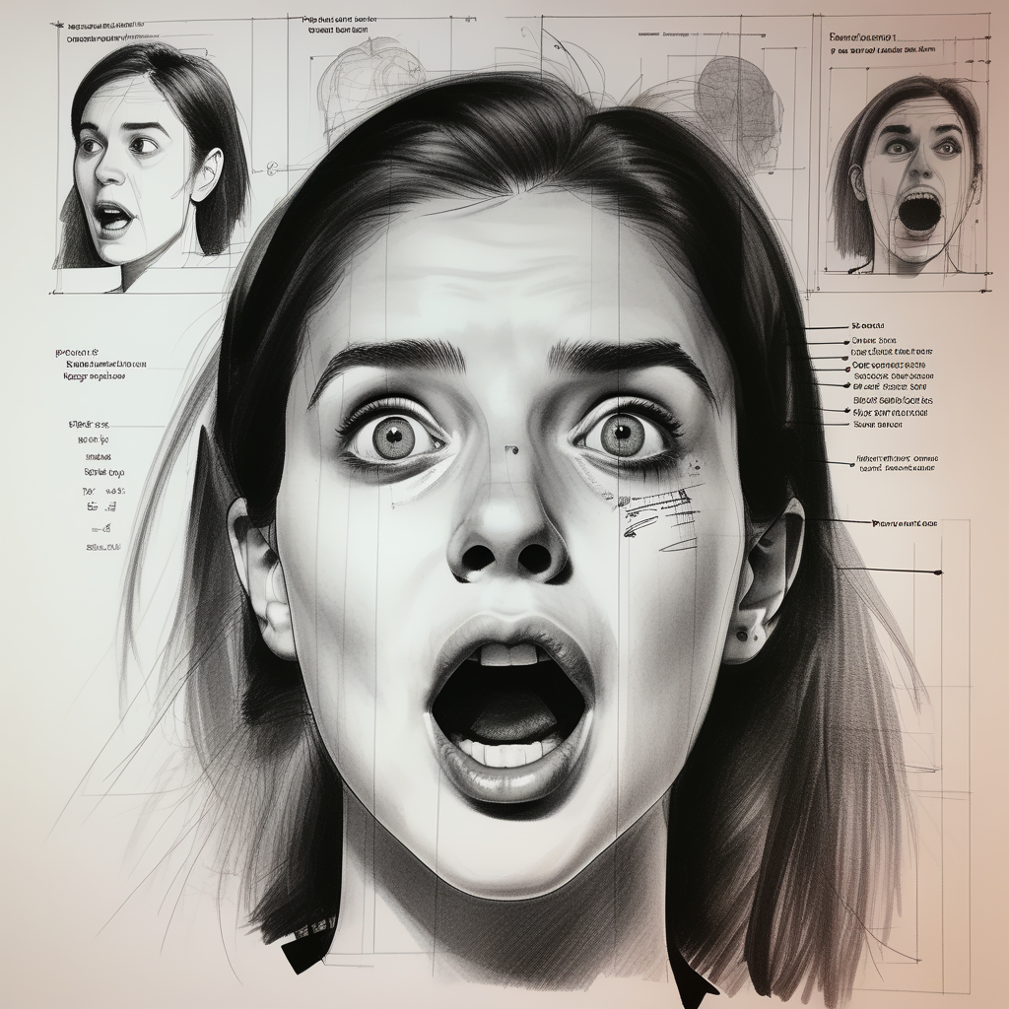
Introduction
Facial expression recognition (FER) is categorizing human expressions from face images.
FER has many practical applications in fields such as security, advertising, healthcare, and entertainment
Recent advancements in deep learning have led to significant progress in FER
Current methods are often resource-intensive and may not be suitable for real-time or mobile applications
Image Source: Generated using Playground-v2 bot on Poe (https://poe.com/Playground-v2)

Slide 3
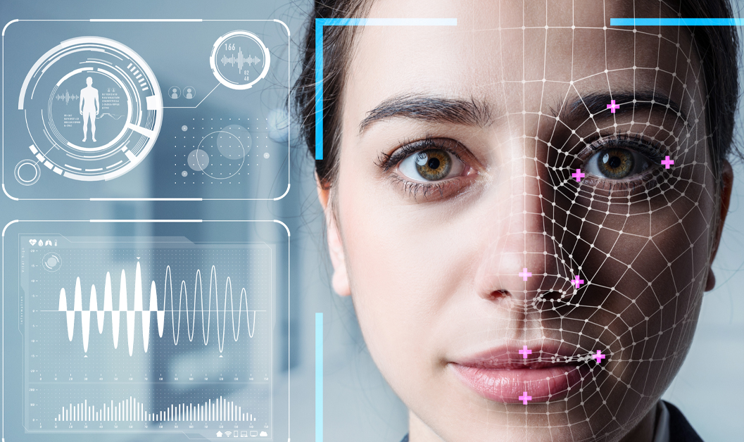

Cont'
Human-computer interaction: used to improve the naturalness and effectiveness of interactions between humans and computers
Healthcare: used to monitor patient progress and detect emotional states in mental health treatment
Entertainment: used to create more engaging and personalized experiences.
Retail: used to analyse customer satisfaction and improve customer service.
Advertising: used to gauge customer engagement and measure the effectiveness of advertising campaigns
Education: used to assess student engagement and performance in online learning environments.
This Photo by Unknown Author is licensed under CC BY-ND

Slide 4
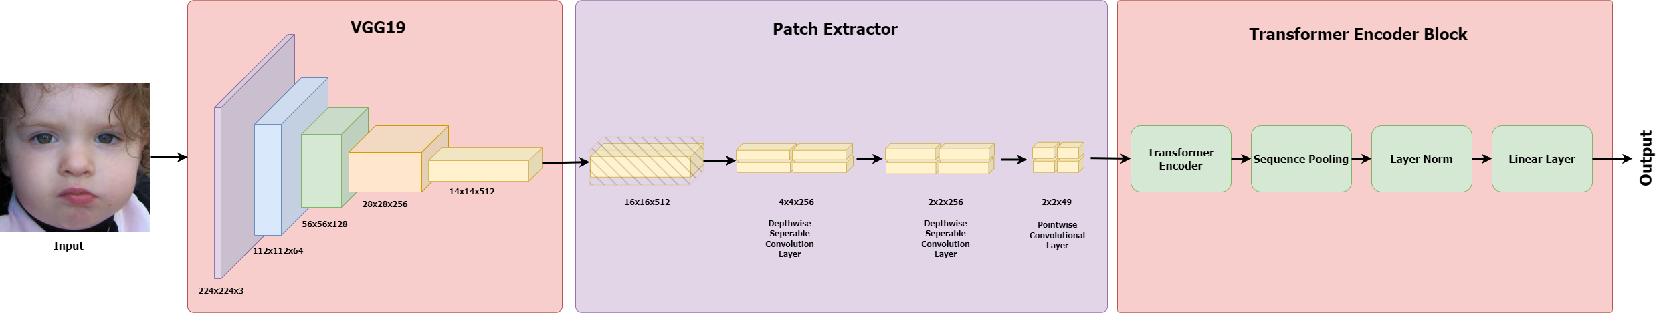
Cont'
This project tries to find a lightweight and efficient method to achieve high performance for the FER task.
Proposed models combines CNNs and transformers for efficient facial expression recognition (FER)
Achieves 55.54% accuracy on 8 classes with lightweight 5.67M parameters on AffectNet database
Backbone

Slide 5
Emotion Modeling
Dimensional Model:
The emotions are defined in a multidimensional continuous space.
Two dimensional models use valence and arousal as dimensions
Three dimensional models add also dominance to the valence and arousal.
Valence signifies the intensity of the pleasantness
Arousal indicates the level of physiological activity
Dominance is recognized as attention.
Exp. Circumplex Model, PAD
Categorical Model:
The emotions are defined as distinct classes.
Basic set of emotions or more complex set tailored to problem domain
Basic emotions can be combined to create more complex emotions
Widespread use for annotations of emotions in datasets.
Exp. Ekman’s 6 basic emotions, Plutchik’s emotional wheel

Slide 6
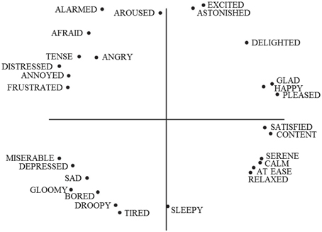
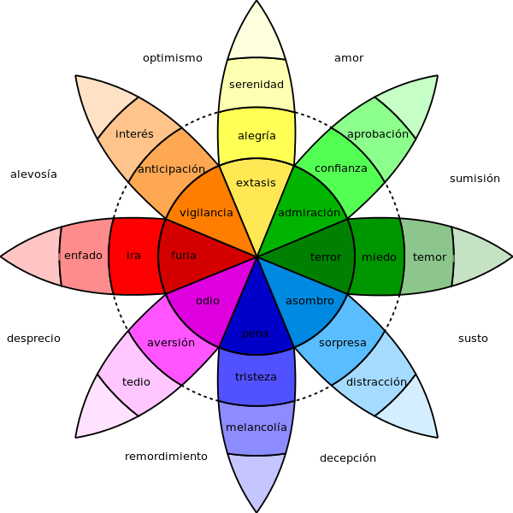
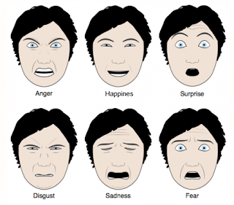
Cont'
This Photo by Unknown Author is licensed under CC BY
Circumplex Model
This Photo by Unknown Author is licensed under CC BY-SA
Plutchik’s emotional wheel
Ekman’s 6 Basic Emotions
This Photo by Unknown Author is licensed under CC BY-SA

Slide 7
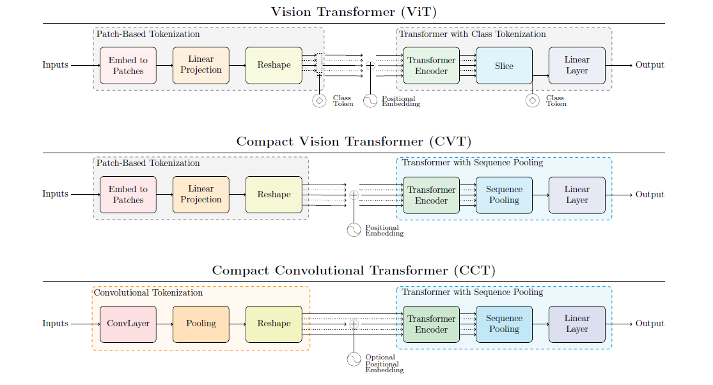
Method
CNNs were default choice for vision tasks for a considerable time
Recently, vision transformers or attention-based approaches becoming more popular
CNNs don't scale as well as transformers
Transformers require large amounts of data and compute power
Efforts are being made to combine CNNs and transformers
Image Source: A. Hassani, S. Walton, N. Shah, A. Abuduweili, J. Li and H. Shi, "Escaping the Big Data Paradigm with Compact Transformers," arXiv preprint arXiv:2104.05704, 2022.

Slide 8
Cont'
Backbone
Backbone Network for extracting fine level features.
MFN or Truncated VGG19
Patch extractor is applied to extract relevant features from facial patches.
The patch extractor consisted of two depthwise separable convolutions and one pointwise convolution
Compact Convolutional Transformer
Original Encoder layers followed by Sequence pooling.
Sequence pooling allows the network to concentrate on specific segments of the input sequence after the encoder has processed it.

Slide 9
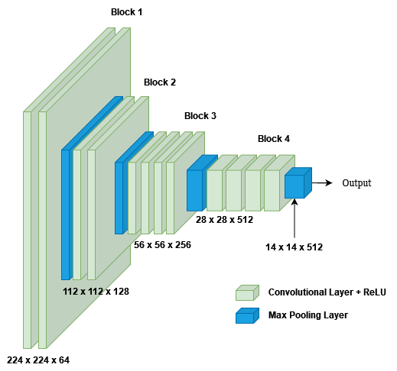
Cont'
VGG19:
Truncated after 4th pooling layer
Simple and uniform architecture
Applied various tasks and data sets

Slide 10
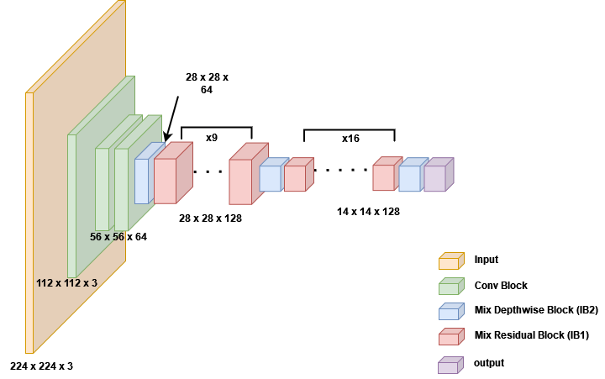
Cont'
Mixed Feature Network (MFN):
Lightweight network
Specifically designed to be suitable for face verification tasks

Slide 11
Data Pre-processing
Training and evaluation performed on AffectNet database.
Official small version of dataset employed
All images collected by querying the web and manually annotated by professionals
Officially provided validation set used for testing purposes
500 examples randomly sampled from each category for validation
Channel-wise normalization and Random Augmentation is applied.
Labels | Training | Validation | Test
 | Number
Neutral | 74374 | 500 | 500
Happy | 133915 | 500 | 500
Sad | 24959 | 500 | 500
Surprise | 13590 | 500 | 500
Fear | 5878 | 500 | 500
Disgust | 3303 | 500 | 500
Anger | 24382 | 500 | 500
Contempt | 3250 | 500 | 499

Slide 12
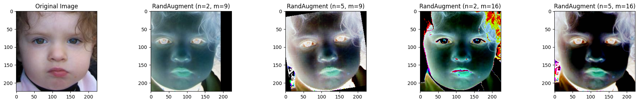
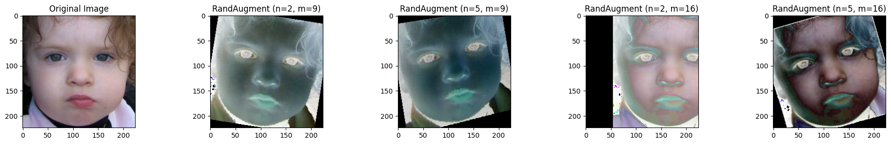
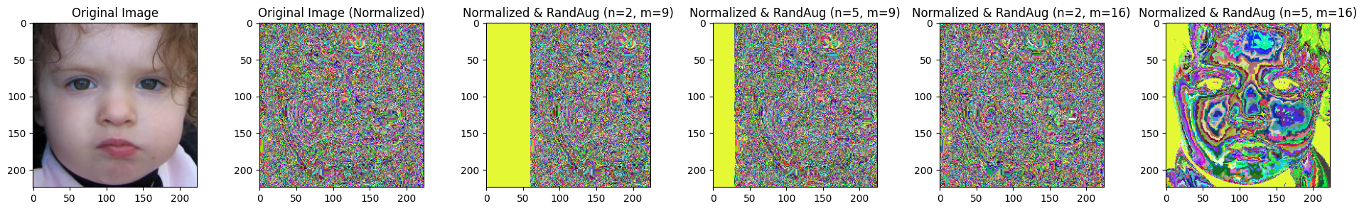
Cont'

Slide 13
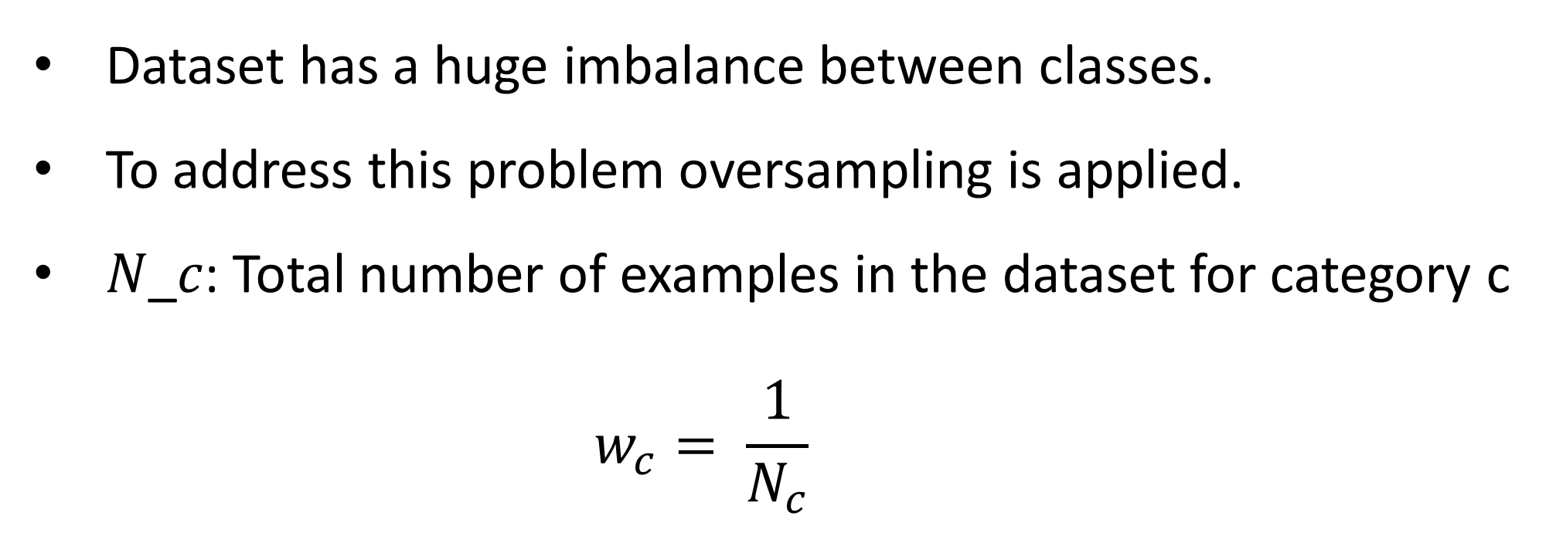
Cont'
Class | Weight
Neutral | 0.477
Happiness | 0.265
Sadness | 1.421
Surprise | 2.609
Fear | 6.032
Disgust | 10.735
Anger | 1.454
Contempt | 10.91
Dataset has a huge imbalance between classes.
To address this problem oversampling is applied.
𝑁_𝑐: Total number of examples in the dataset for category c
$$w_{c}= \frac{1}{N_{c}}$$

Slide 14
Training Procedure
Results
Batch size: 32
Optimizer AdamW with β_1=0.9 and β_2=0.999
Learning rate = 0.001
12 Model is trained using 6 variants for at least 10 epoch
First letter denotes the backbone network
The number represents the number of encoder layers
Models with a * trained without oversampling
Model | Performance | #Params
VCCT-1 | %53.49 | 11.26M
VCCT-2 | %53.41 | 11.71M
*MCCT-1 | %48.19 | 3.00M
MCCT-1 | %53.24 | 3.00M
*MCCT-2 | %44.16 | 3.44M
MCCT-2 | % 54.19 | 3.44M
*MCCT-3 | %41.49 | 3.89M
MCCT-3 | %51.21 | 3.89M
*MCCT-6 | % 45.26 | 5.23M
MCCT-6 | % 52.79 | 5.23M
*MCCT-7 | % 40.79 | 5.67M
MCCT-7 | % 55.54 | 5.67M

Slide 15
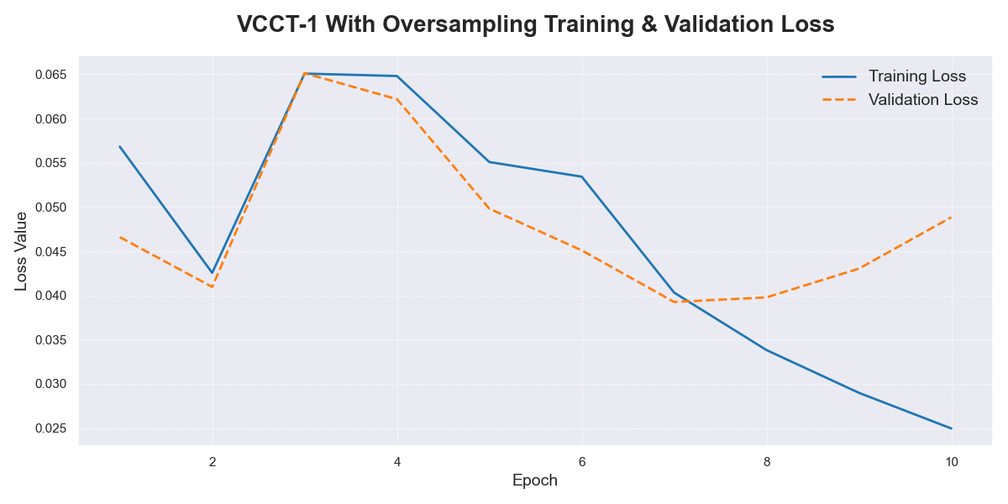
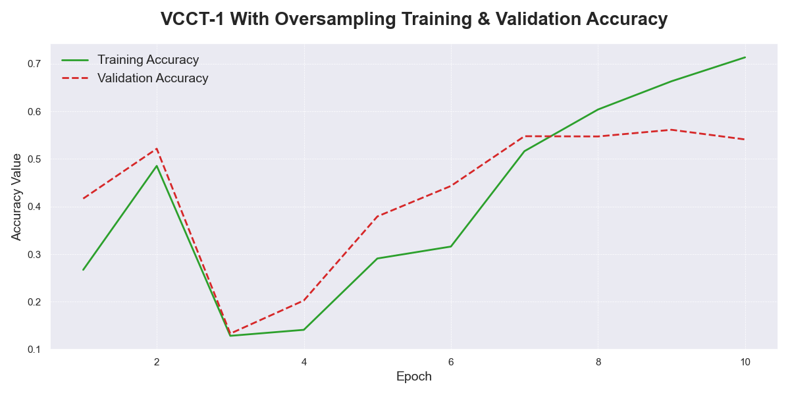
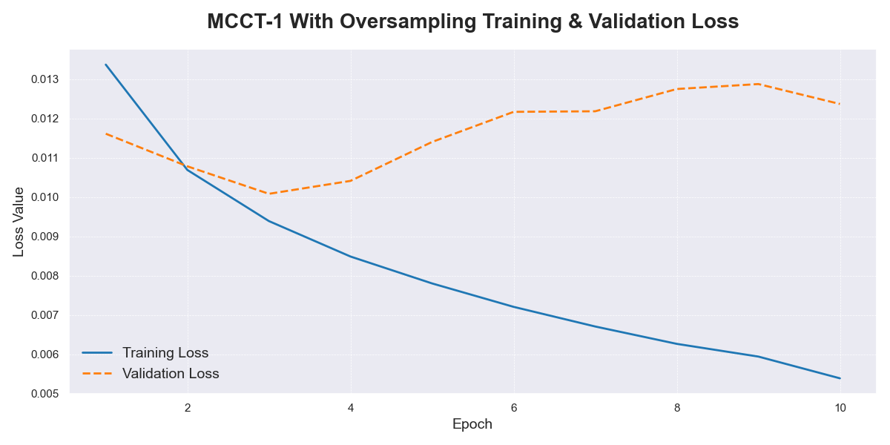
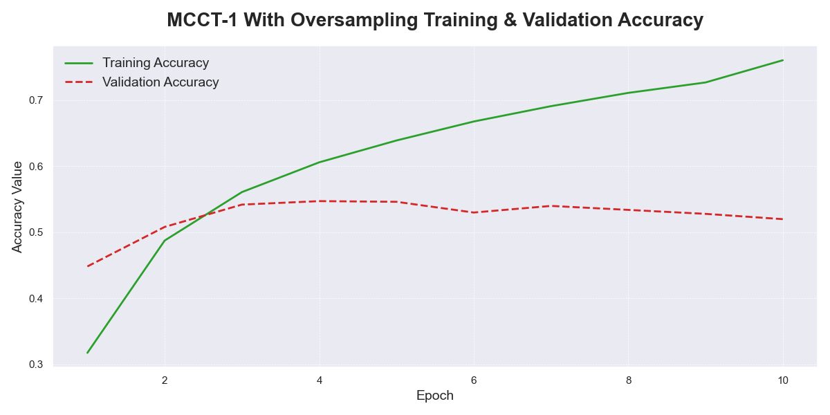
Cont'

Slide 16
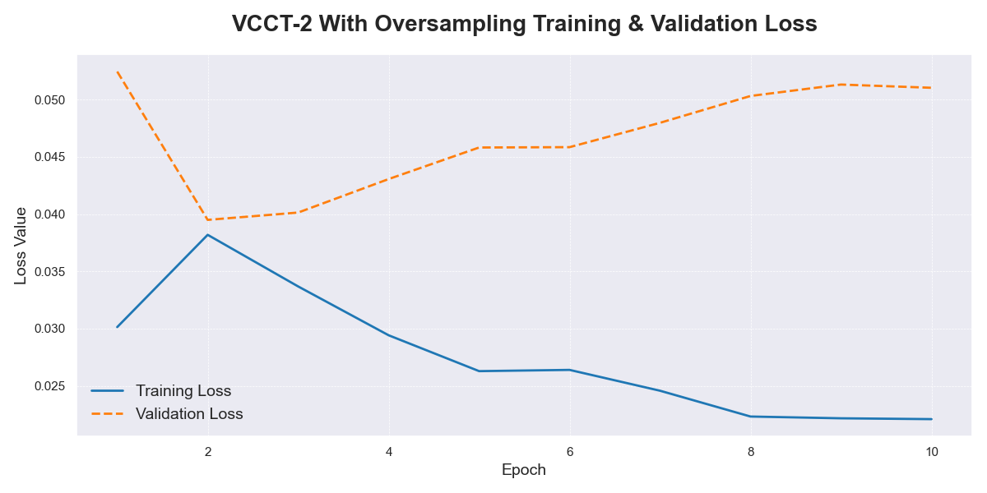
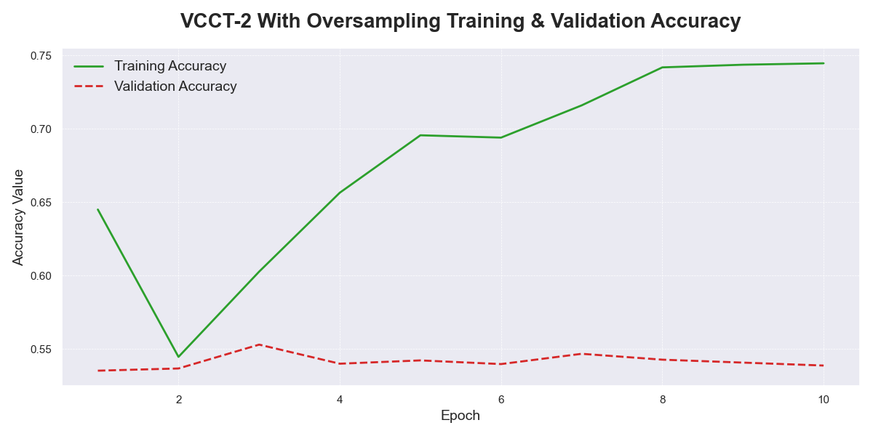
Cont'

Slide 17
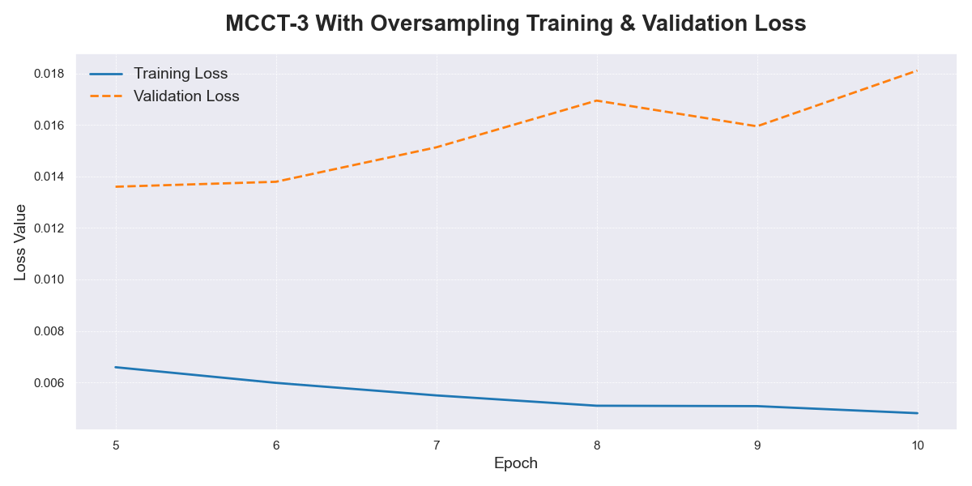
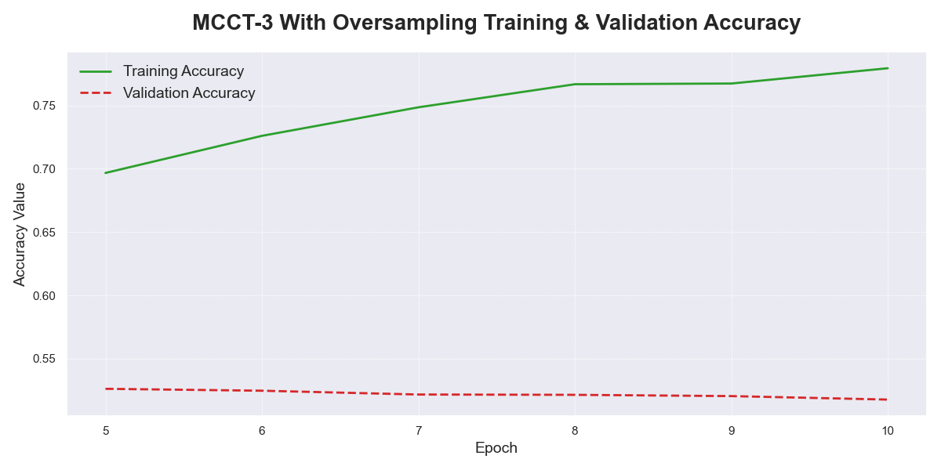
Cont'

Slide 18
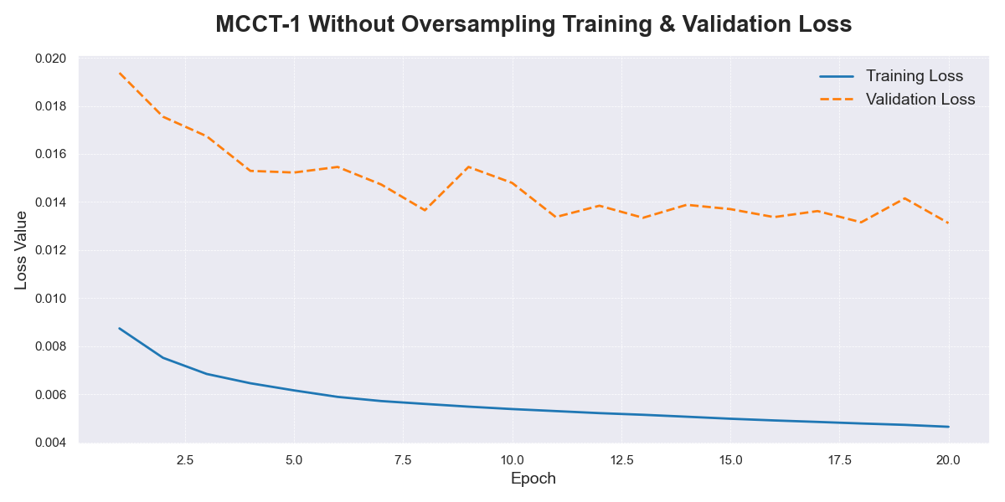
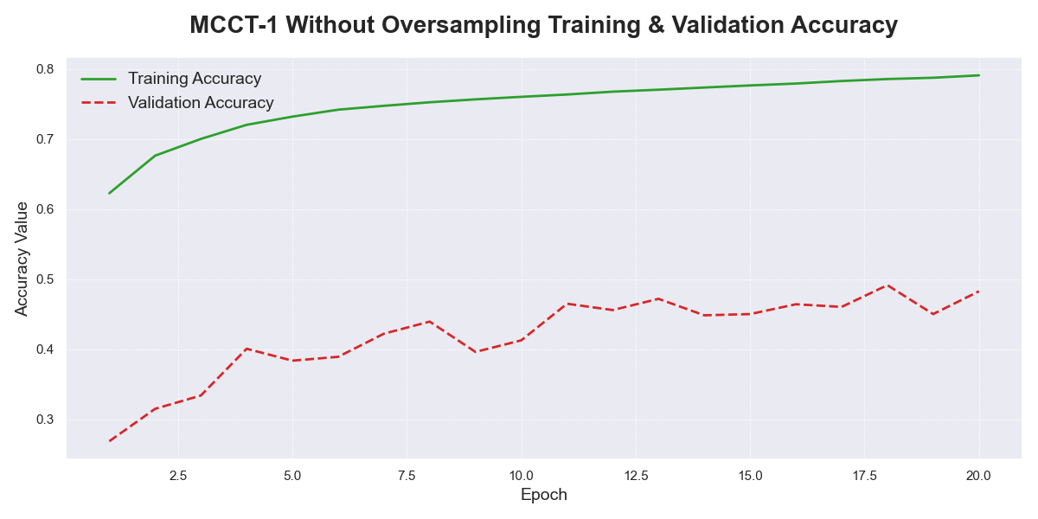
Cont'

Slide 19
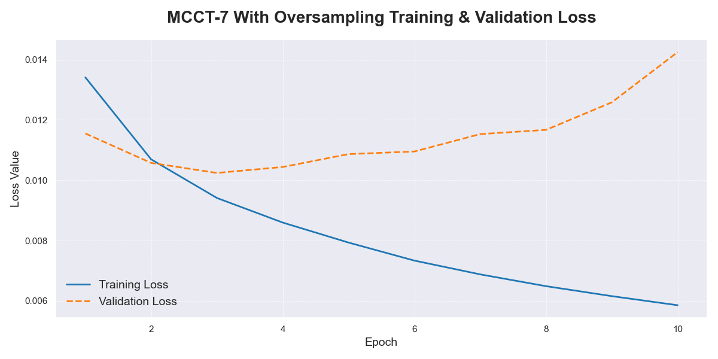
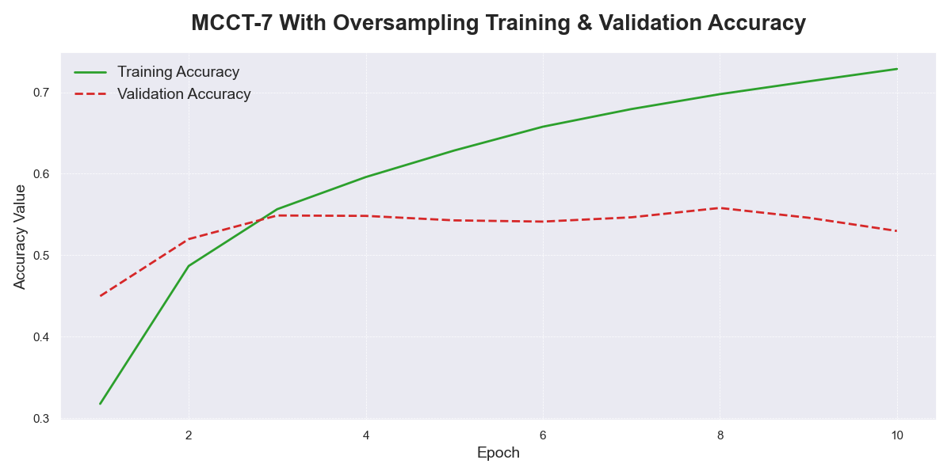
Cont'

Slide 20
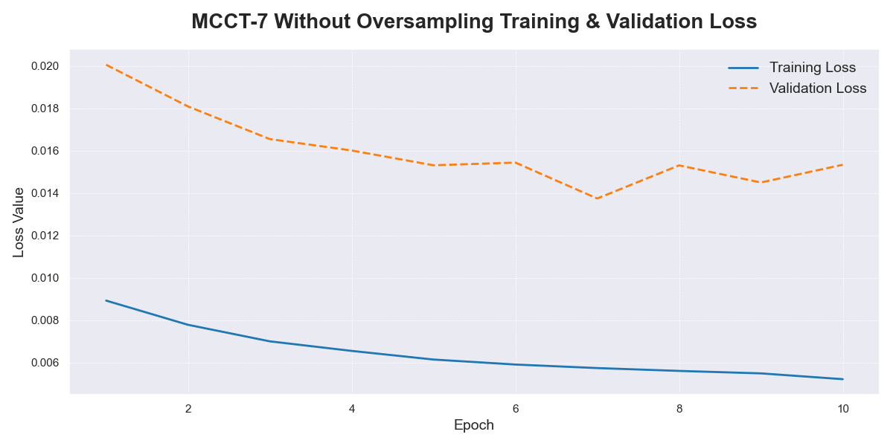
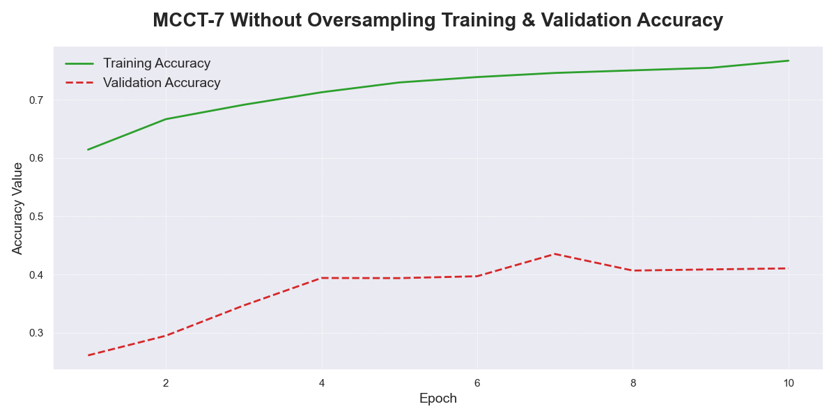
Cont'

Slide 21
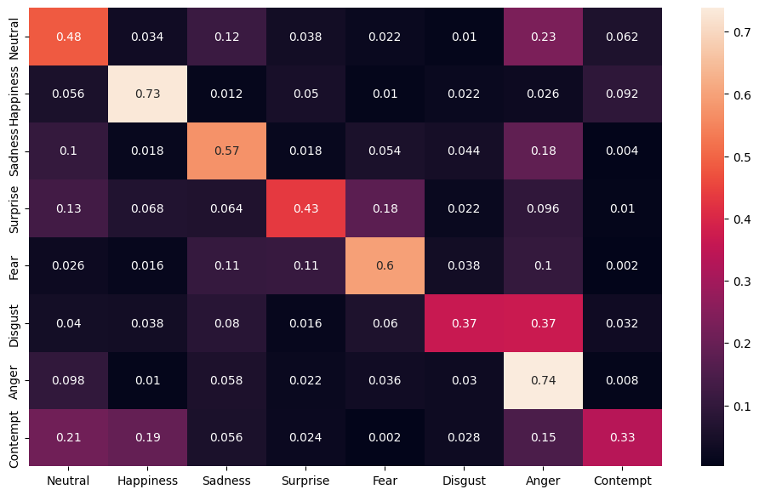
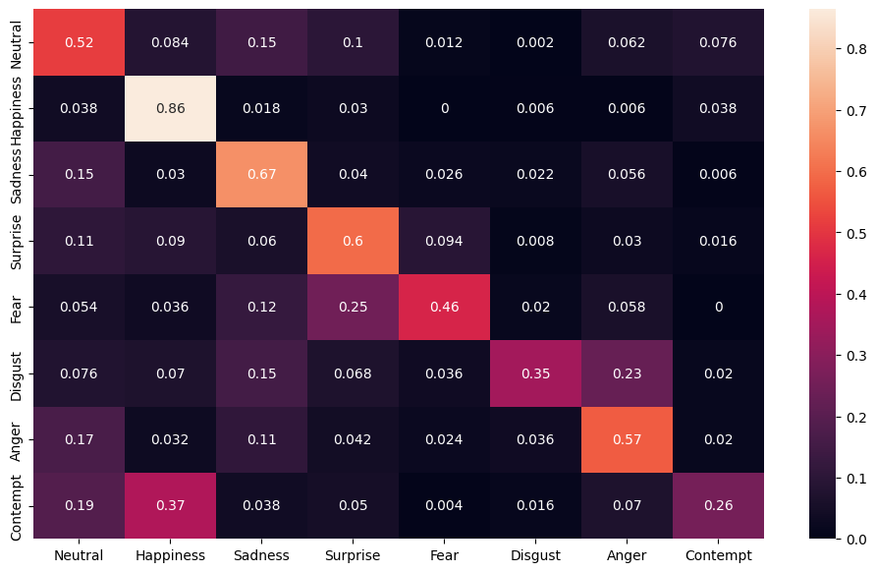
Cont'
MCCT-1 (OS)
VCCT-1 (OS)

Slide 22
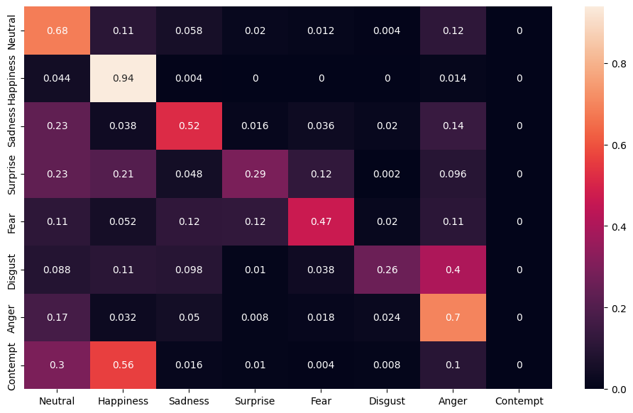
Cont'
MCCT-1 (OS)
MCCT-1

Slide 23

Cont'
MCCT-1 (OS)
MCCT-2 (OS)

Slide 24
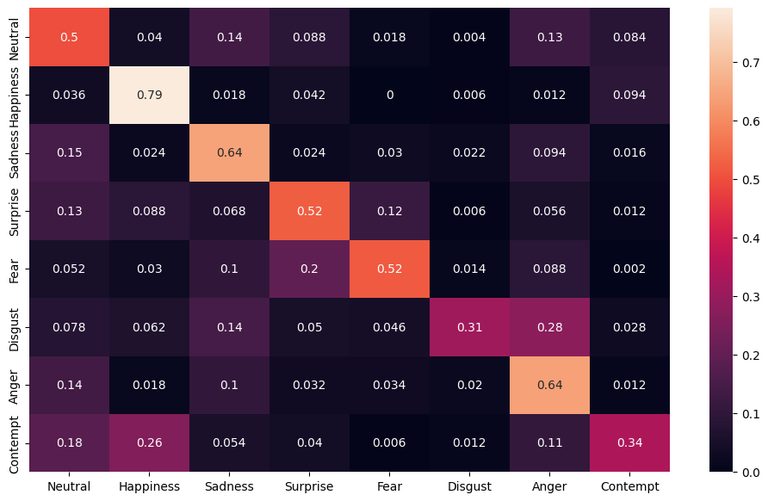
Cont'
VCCT-1 (OS)
VCCT-2 (OS)

Slide 25
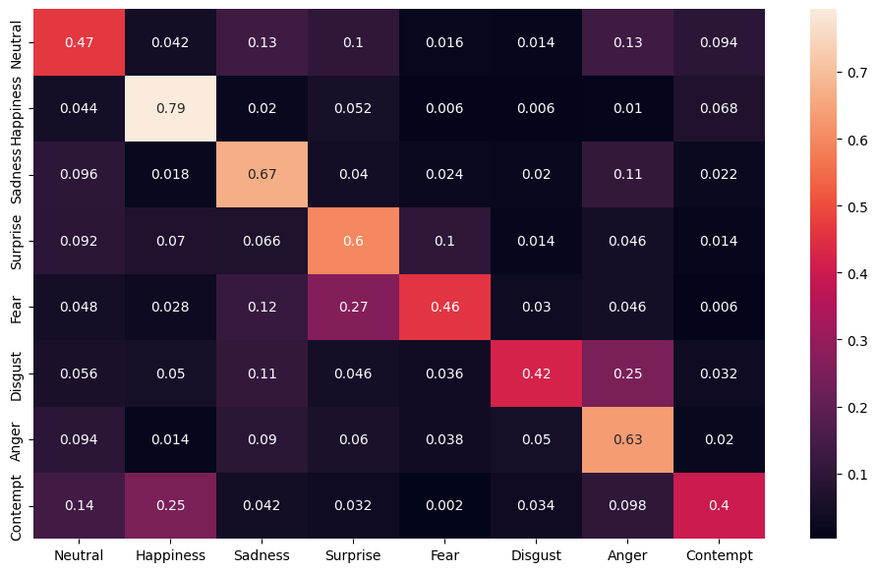
Cont'
MCCT-1 (OS)
MCCT-7 (OS)

Slide 26
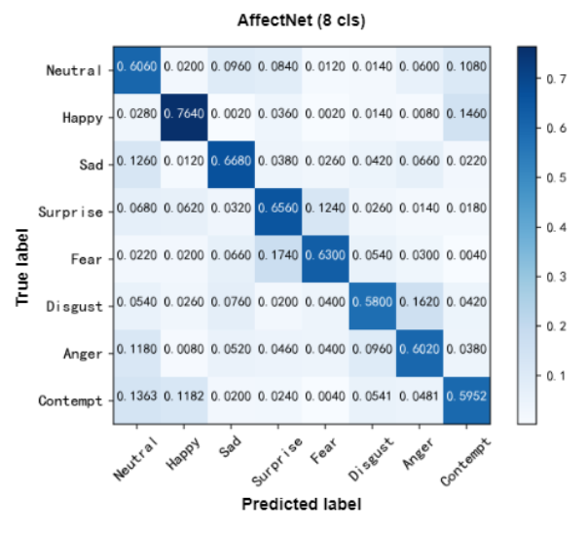
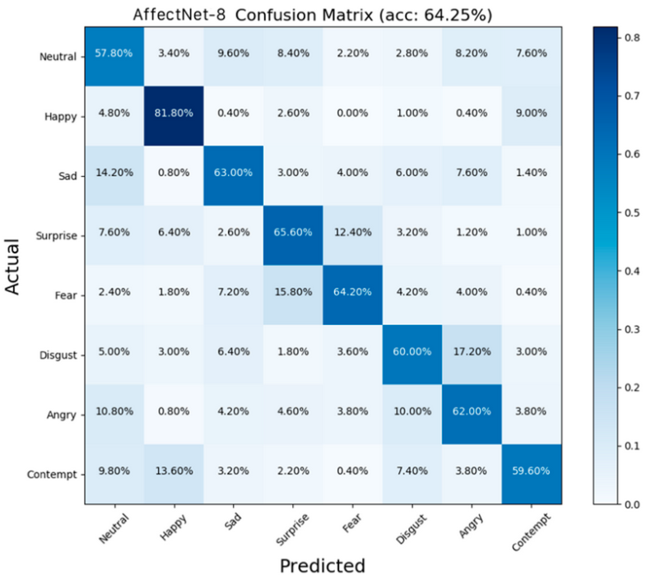
Cont'
Image Source: J. Mao, R. Xu, X. Yin, Y. Chang, B. Nie and A. Huang, "POSTER V2: A simpler and stronger facial expression recognition network," arXiv preprint arXiv:2301.12149, 2023.
Image Source: S. Zhang, Y. Zhang, Y. Zhang, Y. Wang and Z. Song, "A Dual-Direction Attention Mixed Feature Network for Facial Expression Recognition," Electronics, vol. 12, no. 17, p. 3595, 2023.
MCCT-7 (OS)

Slide 27
Conclusion
Future Work
Best performing variant MCCT-7 achieved %55.54 on officially provided AffectNet validation set on 8 classes.
Performing closer to or better than current best performing models in some categories
Oversampling proved to enhance performance in all variants experimented with
MCCT-1 showed better performance on 20 epochs compared to 10 epochs, even though it was overfitting.
This suggests that MCCT-7 could also benefit from increased training epochs.
Explore use of different backbone networks to improve efficiency
Explore use of different optimizers
Conduct more rigorous search for hyperparameters of random augmentation or explore different data augmentation techniques
Switch optimizer from AdamW to Stochastic Gradient Descent (SGD) to improve generalization ability

Slide 28
Thank You For Listening

